Slide 1
Text Detection for Natural Scene based on MobileNet V2 and U-Net
Department of Information Science and Intelligent Systems
Graduate School of Advanced Technology and Science
Tokushima University, Japan
付 康为 (Kangwei Fu)
A1 Group

Slide 2
CONTENTS
Introduction
Related Work
Light-weight text detector for natural scene
Data Augmentation
Experiment
Conclusion and future work
Notes:
This is my contents, which is divided into five parts.

Slide 3
Introduction

Slide 4

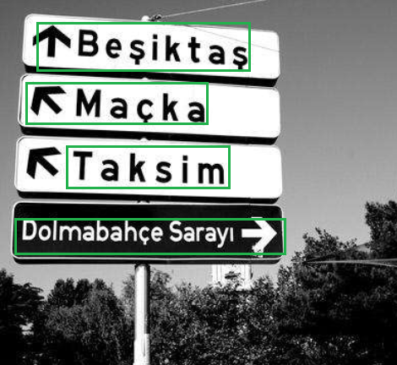
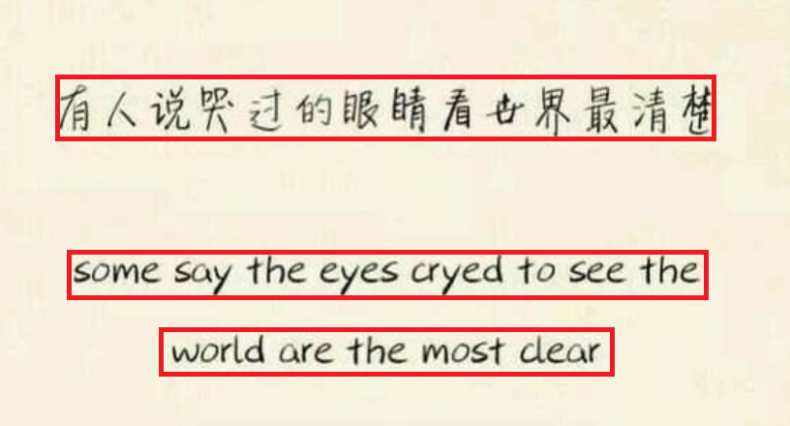
Technology of text detection
Obtain important text information from natural scene.
Great challenge in computer vision field.
Multi-scale and multi-orientation text areas.

Slide 5

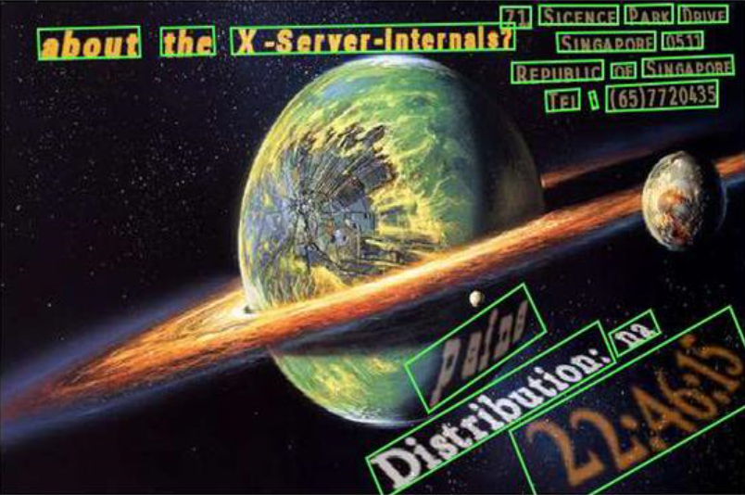

Method based on Deep Learning
Improve the accuracy of text detection greatly
CTPN VGG
Fused Text Segmentation Network ResNet
Large-scale
Complex
Shortcoming
Consume many computing resources
Difficult to adopt them on the mobile platforms

Slide 6
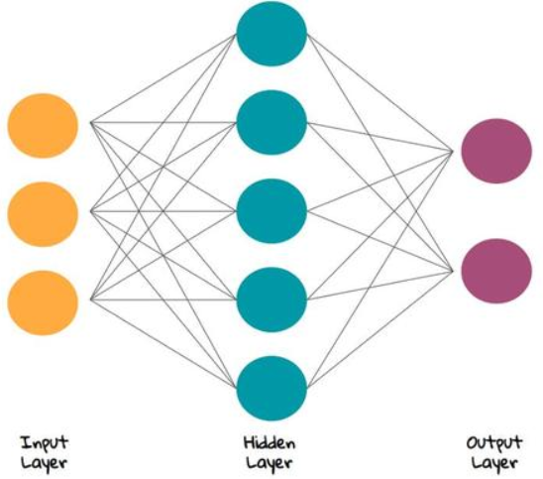
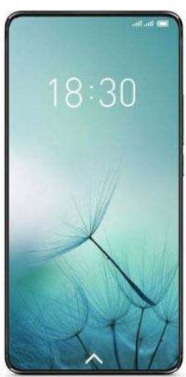
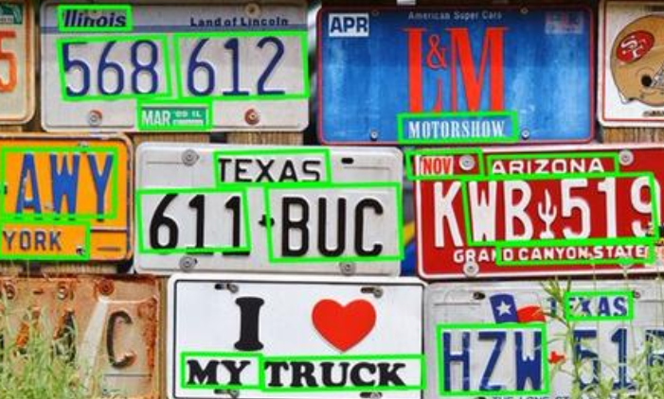
Our Purpose
Design a light-weight text detector for natural scene
Low complexity, and few parameters of neural network
Make this text detector suitable for mobile devices

Slide 7
Related Work

Slide 8
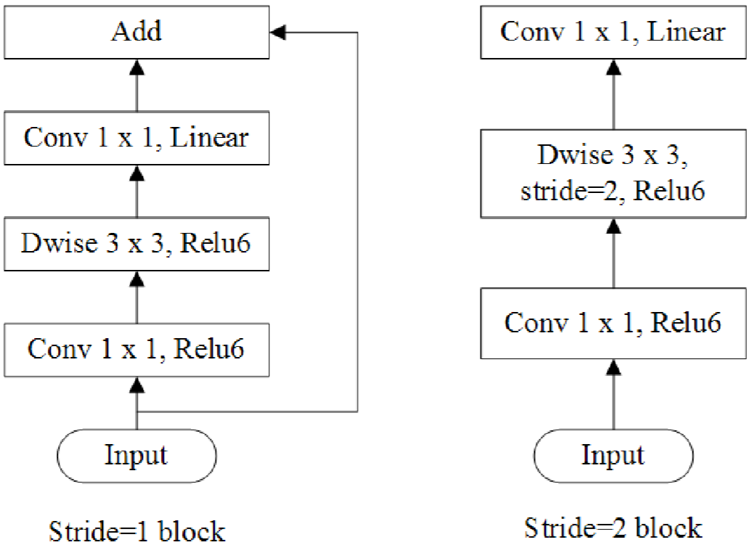
Light-weight Neural Network
Traditional opinion: Deeper network makes stronger performance.
Light-weight network also have the great performance with few parameters.
MobileNet V2

Slide 9
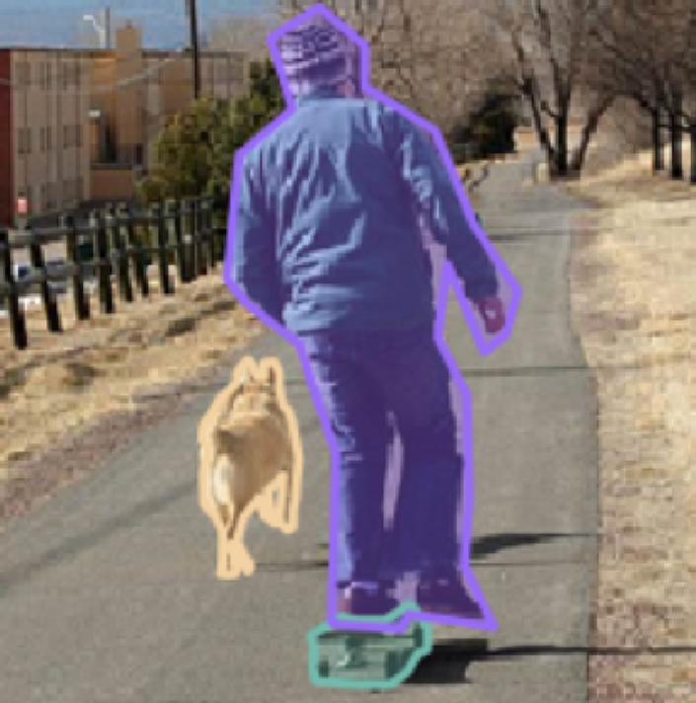
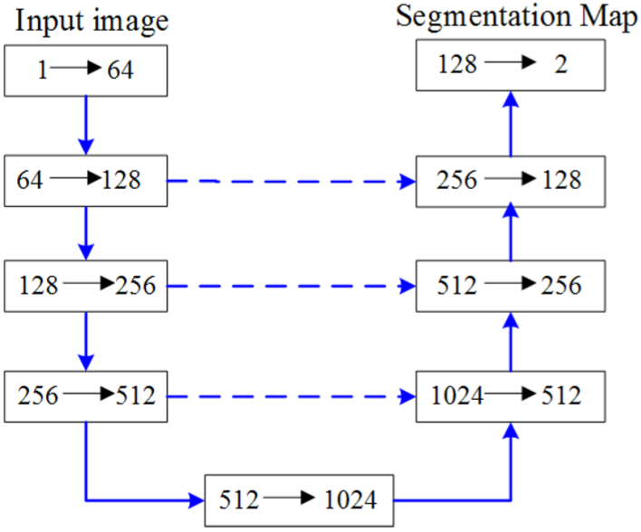
Image Semantic Segmentation
Classify each pixel in the image.
Determine the category of each pixel.
U-Net

Slide 10
Light-weight text detector for natural scene

Slide 11
Pipeline of Text Detection
（1）
（2）
（3）
Use MobileNet V2 to extract text features from the natural scene image.
Use U-Net to perform the semantic segmentation operation for the image.
Mask image of text areas is generated then.

Slide 12
Pipeline of Text Detection
（5）
（4）
Use OpenCV to obtain the outline of the mask.
Map the outline onto the original image.

Slide 13
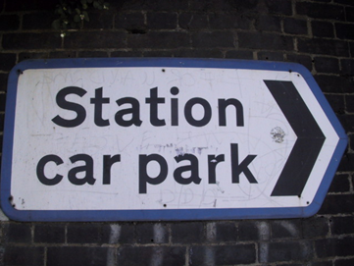

Architecture of neural network
Classify the pixels of the image into two categories:
Text areas
Non-text areas
Original
Image
Mask
Image

Slide 14
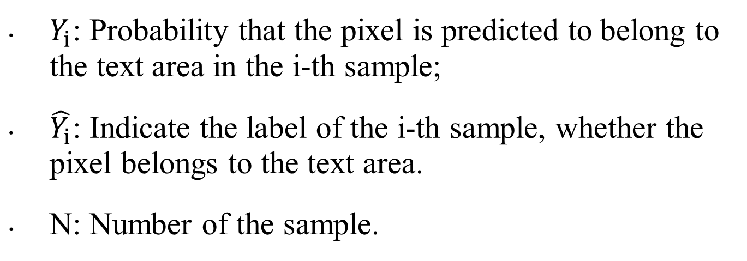
Loss Function
Extract

Slide 15
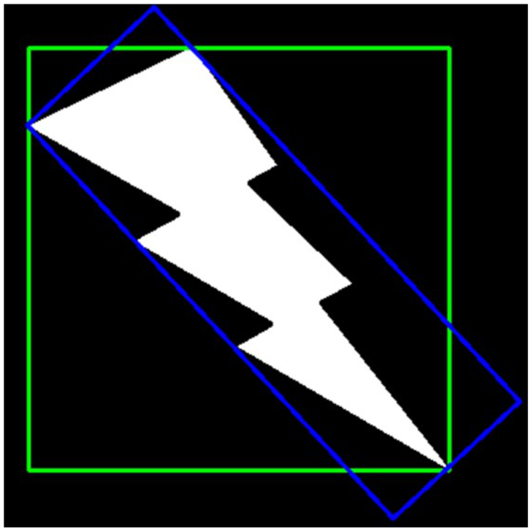
Our method for text detection
Enclosing rectangle (Green).
Minimum enclosing rectangle (Red).

Slide 16
Our method for text detection
Use enclosing rectangles to surround every text on the mask image.
Extend the boundaries of enclosing rectangles.
Fill these enclosing rectangles.
Use minimum enclosing rectangles to surround the filled areas.
Map the outline of minimum enclosing rectangles onto the original image.

Slide 17
Data Augmentation

Slide 18
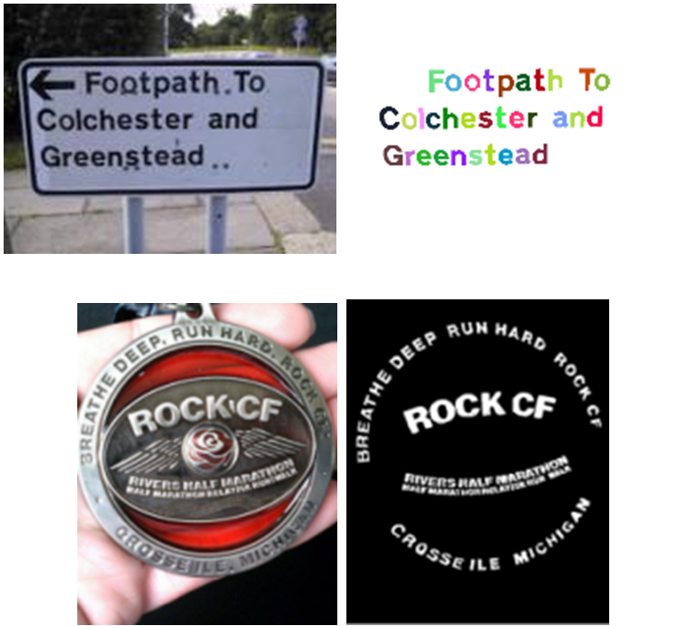
Data Augmentation
ICDAR 2013
Total-Text and ICDAR 2013.
Both are small datasets.
Over-fitting is easy to take place.
Data augmentation is necessary.
Total-Text

Slide 19
Data Augmentation
New sample
Use a sliding window with size (448, 448).
Cut the original image and its corresponding mask simultaneously.
Save the part cut from the image as a new sample.

Slide 20
Data Augmentation
Move this window right, repeat the above process, until reaching the right edge of this image.
Move the sliding window down, repeat the above process.
Effect of data augmentation

Slide 21
Experiment

Slide 22
Image Semantic Segmentation Experiment
(a): Original image.
(b): Ground truth, the manually labeled text areas.
(c): Text areas predicted by the neural network model.

Slide 23

Text Detection Experiment
Detect the text areas with multi-orientations.
Detect the text areas with different sizes and colors.
Actual effect of text detection

Slide 24
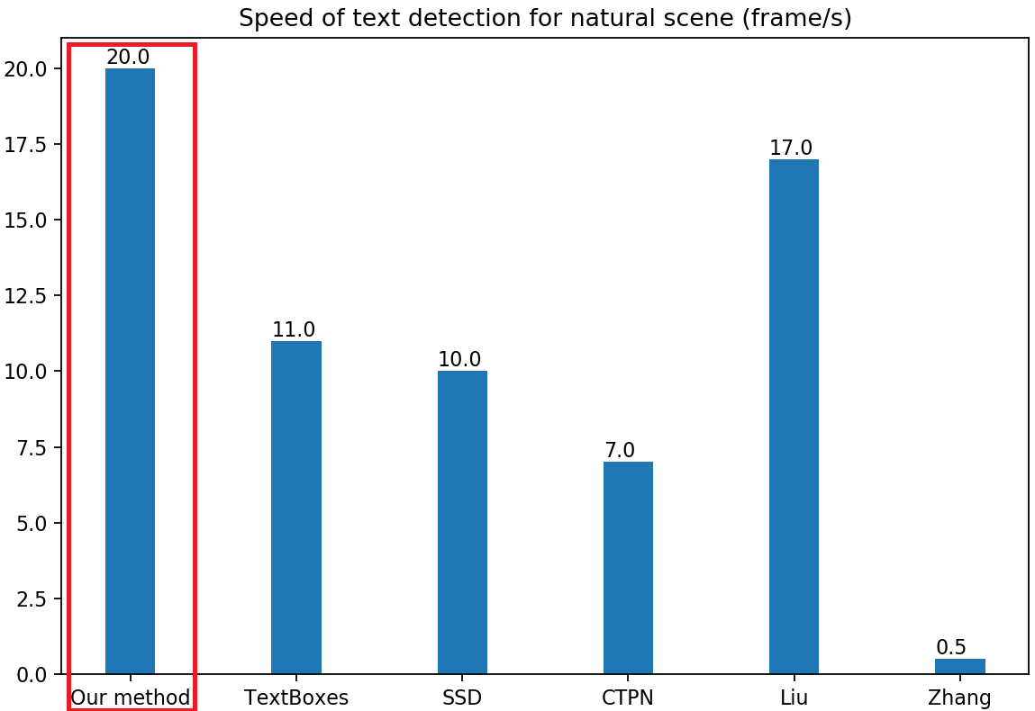
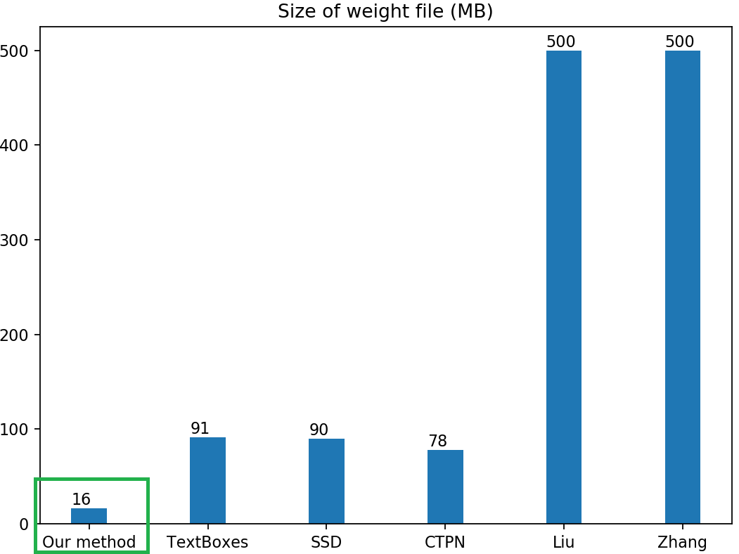
Comparison with other methods
Faster than other methods.
Generate the smaller weight file.
Consume fewer computing resources.

Slide 25
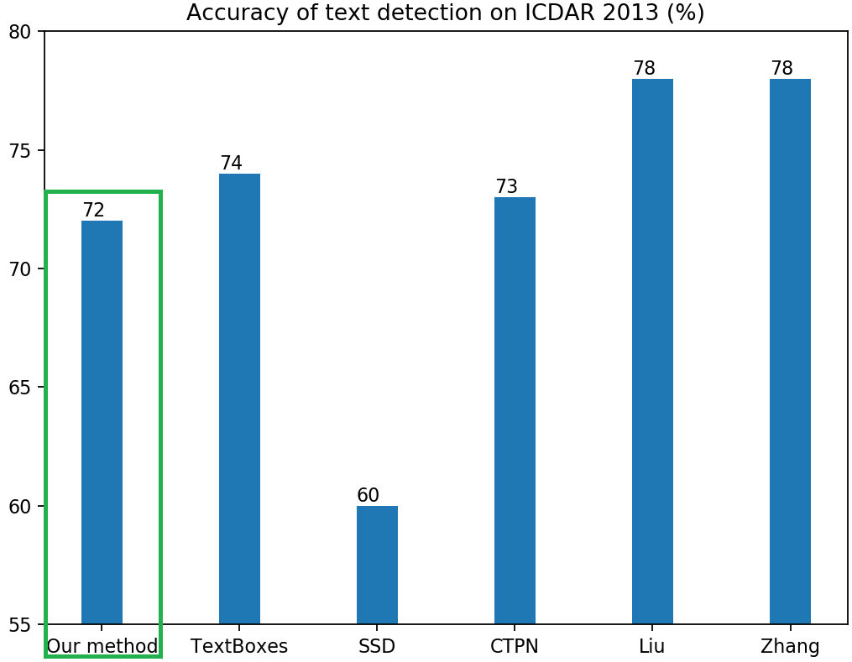
Comparison with other methods
The method has a slight loss in the accuracy.

Slide 26
Conclusion and future work

Slide 27
Conclusion
This detection method has a great effect on text detection for natural scene.
We design a new neural network model based on MobileNet V2 and U-Net, which has low complexity.
This model generates the smaller weight file, which is suitable for mobile devices.
We use a new method for obtaining text areas, and prove that it is faster than other method.

Slide 28
Future work
Improve our method for the higher accuracy of text detection.

Slide 29
THANKS!

